Slide 1
CV 16:
Note on Performance Metrics & Course Summary
CV 16: Note on Performance Metrics and wrap up

Slide 2
Agenda for the class
Mean Average Precision (mAP)
ROC

Slide 3
Confusion Matrix (revisiting)
Precision: fraction of retrieved docs that are relevant
P(relevant|retrieved)
Recall: fraction of relevant docs that are retrieved
P(retrieved|relevant)
Precision P = tp/(tp + fp)
Recall R = tp/(tp + fn)
 | Relevant | Non-Relevant
Retrieved / Predicted Positive | tp | fp
Not Retrieved / Predicted Negative | fn | tn
IoU, AUC-PR , mAP

Slide 4
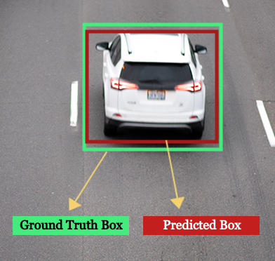
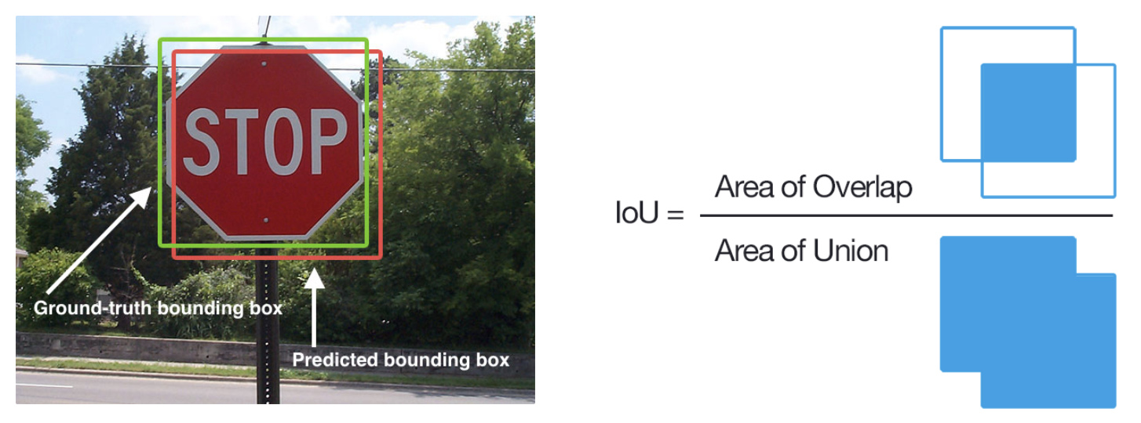
Intersection over Union - IoU (revisiting)
IoU, AUC-PR , mAP

Slide 5
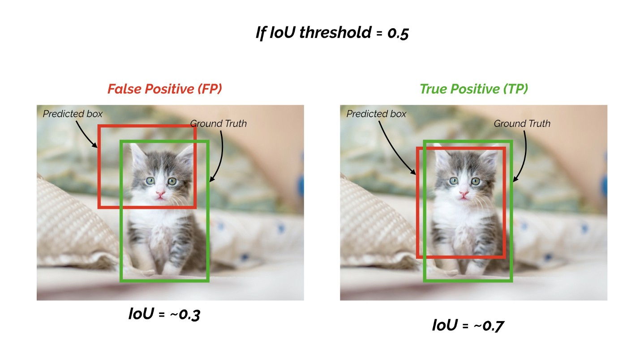
Intersection over Union - IoU (revisiting)
IoU, AUC-PR , mAP

Slide 6
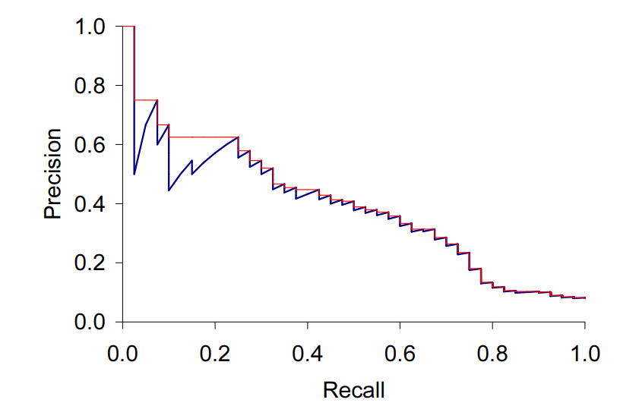

Precision Recall Curve & purpose
IoU, AUC-PR , mAP

Slide 7

Precision Recall Curve & purpose
IoU, AUC-PR , mAP

Slide 8
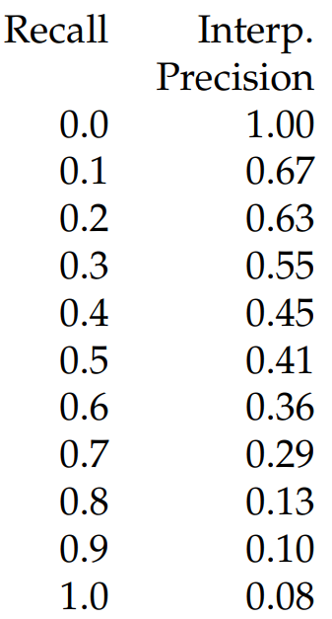
Precision Recall Curve & purpose
IoU, AUC-PR , mAP
Notes:
Calculation of 11-point Interpolated Average Precision.

Slide 9
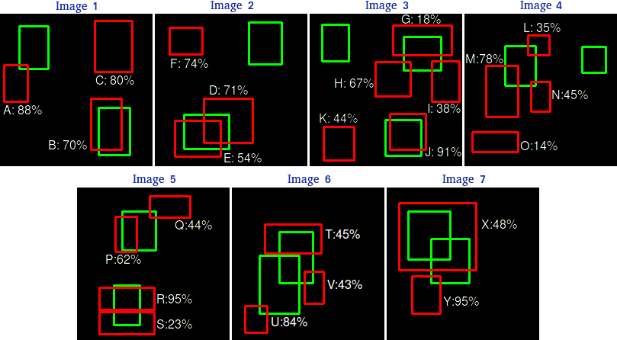
Example:
ROI Proposals = 24
Ground Truths = 15
IoU, AUC-PR , mAP

Slide 10
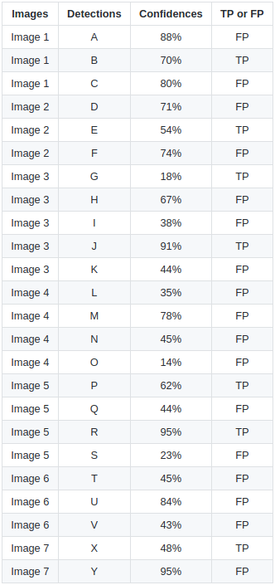
Example:
ROI Proposals = 24
Ground Truths = 15
IoU, AUC-PR , mAP

Slide 11
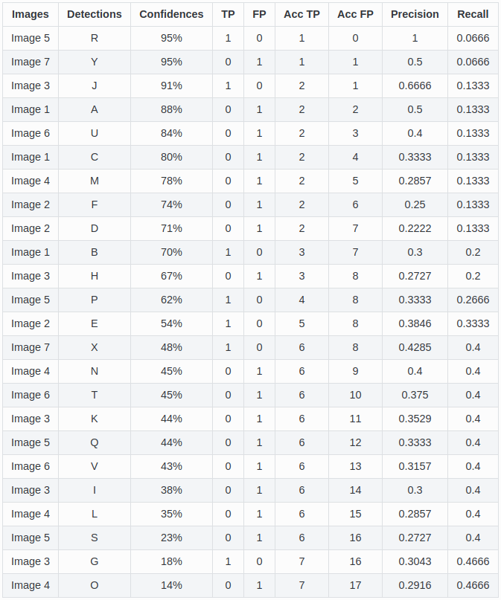
Example:
Ground Truths = 15
IoU, AUC-PR , mAP

Slide 12
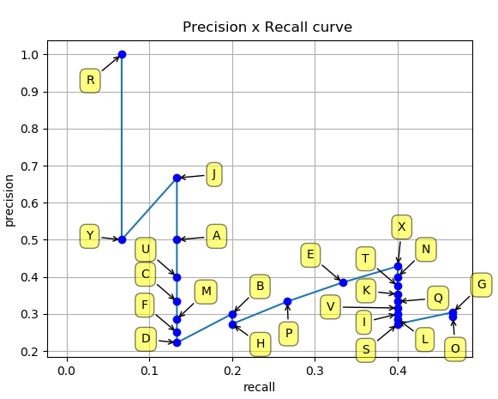
Example:
IoU, AUC-PR , mAP

Slide 13
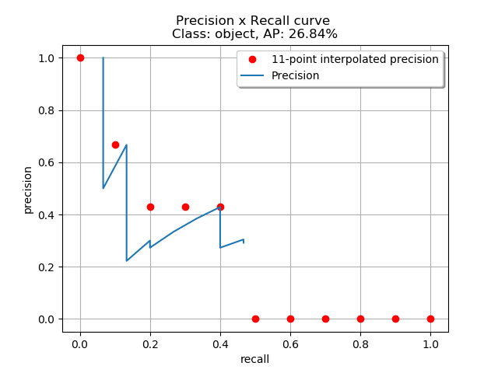
Example:
IoU, AUC-PR , mAP

Slide 14
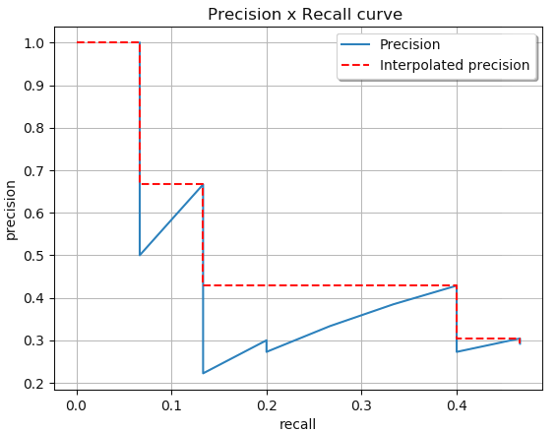
Example:
IoU, AUC-PR , mAP

Slide 15

Example:
IoU, AUC-PR , mAP

Slide 16
Example:
IoU, AUC-PR , mAP

Slide 17
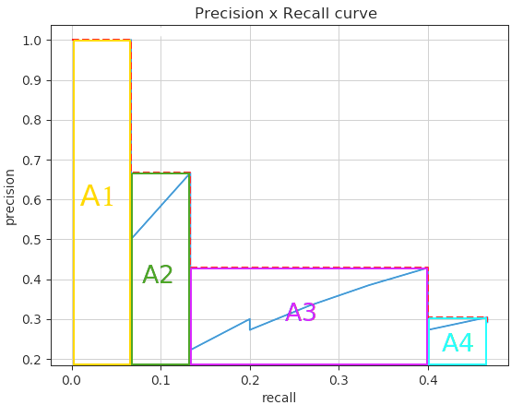
Example:
IoU, AUC-PR , mAP

Slide 18
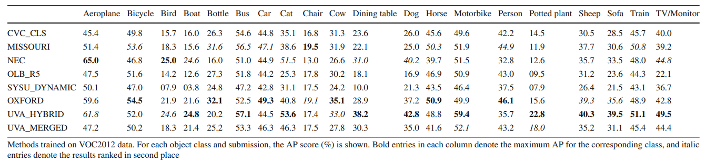
Example:
Source: http://host.robots.ox.ac.uk/pascal/VOC/pubs/everingham15.pdf
IoU, AUC-PR , mAP

Slide 19
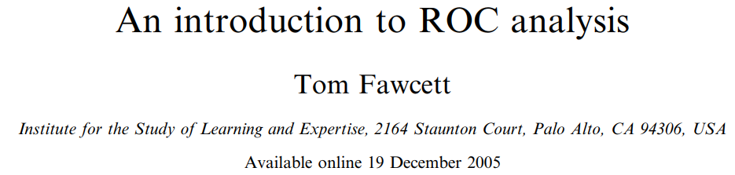
ROC Analysis
Contents are adopted from :
Available from https://people.inf.elte.hu/kiss/13dwhdm/roc.pdf
AU-ROC - Analysis

Slide 20
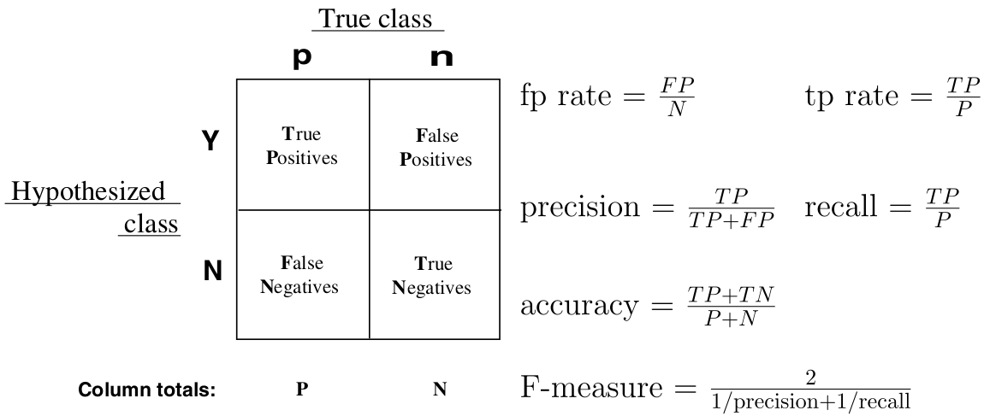
Confusion Matrix ( Again)
AU-ROC - Analysis

Slide 21
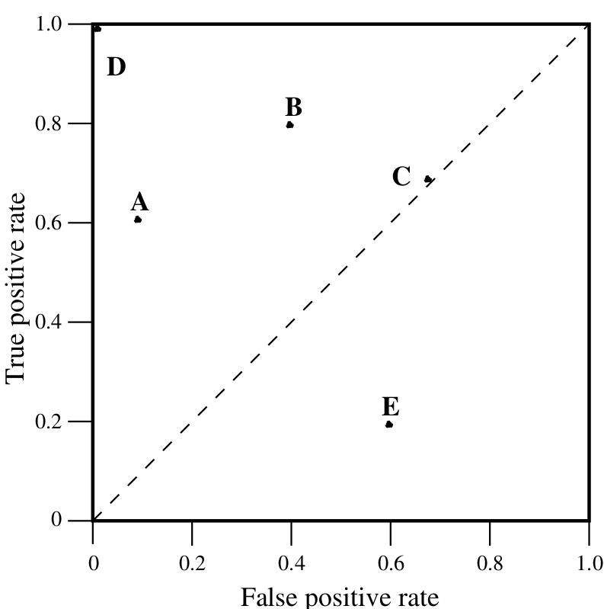
ROC Space
CV 16: Note on Performance Metrics and wrap up
AU-ROC - Analysis

Slide 22
Points in ROC Space
Lower left point (0, 0) represents the strategy of never issuing a positive classification;
Such a classier commits no false positive errors but also gains no true positives.
Upper right corner (1, 1) represents the opposite strategy, of unconditionally issuing positive classifications.
AU-ROC - Analysis

Slide 23
Points in ROC Space
Point (0, 1) represents perfect classification.
D's performance is perfect as shown.
Informally, one point in ROC space is better than another if it is to the northwest of the first
tp rate is higher, fp rate is lower, or both.
AU-ROC - Analysis

Slide 24
Conservative Vs. Liberal
CV 16: Note on Performance Metrics and wrap up
Classifiers appearing on the left hand-side of an ROC graph, near the X axis, may be thought of as “conservative”
they make positive classifications only with strong evidence so they make few false positive errors,
but they often have low true positive rates as well.
AU-ROC - Analysis

Slide 25
Conservative Vs. Liberal
CV 16: Note on Performance Metrics and wrap up
Classifiers on the upper right-hand side of an ROC graph may be thought of as “liberal”
they make positive classifications with weak evidence so they classify nearly all positives correctly,
but they often have high false positive rates.
In figure, A is more conservative than B.
AU-ROC - Analysis

Slide 26
Random Performance
CV 16: Note on Performance Metrics and wrap up
Classifiers on the upper right-hand side of an ROC graph may be thought of as “liberal”
they make positive classifications with weak evidence so they classify nearly all positives correctly,
but they often have high false positive rates.
In figure, A is more conservative than B.
AU-ROC - Analysis

Slide 27
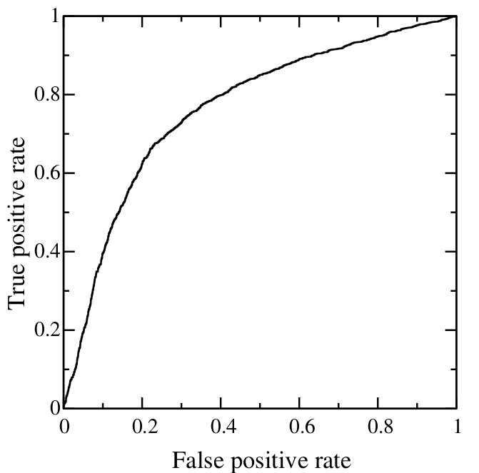
Curves in ROC space
Classifiers, such as decision trees or rule sets, are designed to produce only a class decision, i.e., a Y or N on each instance.
When such a discrete classier is applied to a test set, it yields a single confusion matrix, which in turn corresponds to one ROC point.
Thus, a discrete classifier produces only a single point in ROC space.
AU-ROC - Analysis

Slide 28
Curves in ROC space
Classifiers, such as a Naive Bayes classifier, yield an instance probability or score.
Such a ranking or scoring classier can be used with a threshold to produce a discrete (binary) classier:
if the classier output is above the threshold, the classier produces a Y,
else a N.
Each threshold value produces a different point in ROC space (corresponding to a different confusion matrix).
Conceptually, we may imagine varying a threshold from –infinity to + infinity and tracing a curve through ROC space.
AU-ROC - Analysis

Slide 29
Algorithm
Exploit monotonicity of thresholded classifications:
Any instance that is classified positive with respect to a given threshold will be classified positive for all lower thresholds as well.
Therefore, we can simply:
sort the test instances decreasing by their scores and
move down the list, processing one instance at a time and
update TP and FP as we go.
In this way, an ROC graph can be created from a linear scan
AU-ROC - Analysis

Slide 30
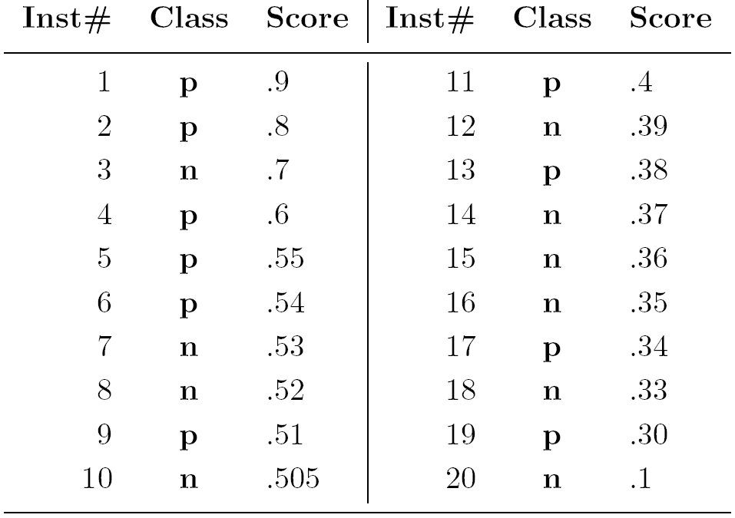
Example
AU-ROC - Analysis

Slide 31
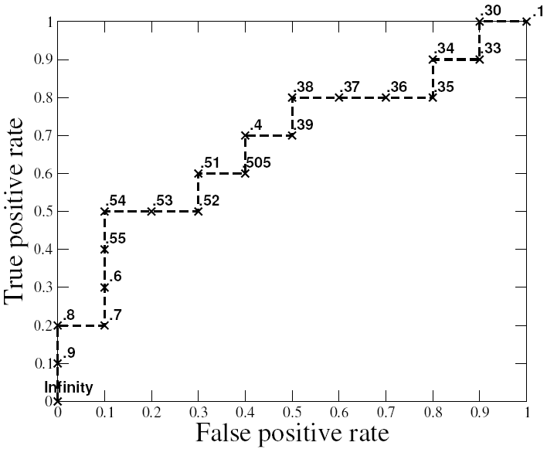
Example
AU-ROC - Analysis

Slide 32
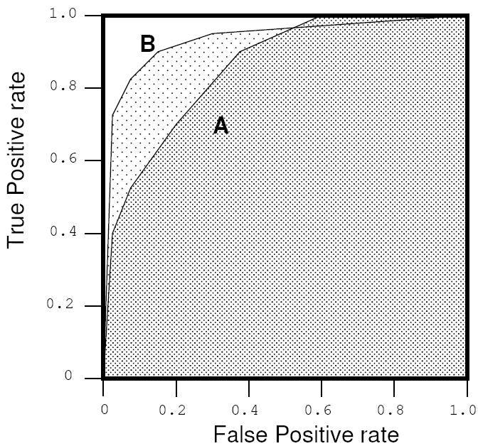
Area under ROC
AUC has an important statistical property:
The AUC of a classifier is equivalent to the probability that the classier will rank a randomly chosen positive instance higher than a randomly chosen negative instance.
Often used to compare classifiers:
The bigger AUC the better
AUC can be computed by a slight modification to the algorithm for constructing ROC curves.
AU-ROC - Analysis

Slide 33
Wrap Up
CV 16: Note on Performance Metrics and wrap up
Comprehensive Exam Syllabus and Pattern for Computer Vision
Weightage - 40%
Number of Questions - 6 Questions ( Each of 6-8 Marks )
Topics Included - Entire Course Coverage
( About 20% -3 questions- upto Midterm exam;
20% -3 questions- post midterm Topics)
For topics and the details, refer to the uploaded slides.

Slide 34
Thank you

